Slide 1
Chapter 2.1 Creating High-Quality Code
CCSW 325 (Software Construction)
Notes:
Last Update: 22/8/2019
Version 1.0

Slide 2

How to create high quality code?

Slide 3
Outline
Key Construction Decisions

Slide 4
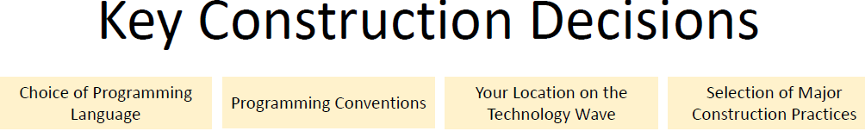
Key Construction Decisions
Notes:
Coding conventions are a set of guidelines for a specific programming language that recommend programming style, practices, and methods

Slide 5
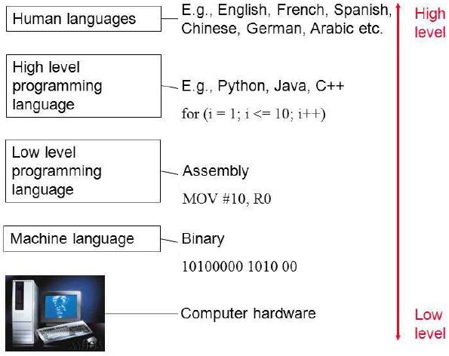
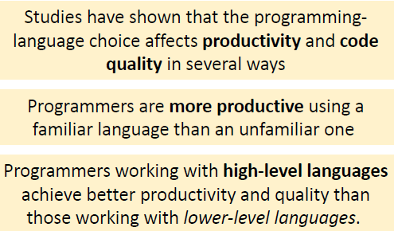
1- Choice of Programming Language

Slide 6

1- Choice of Programming Language

Slide 7
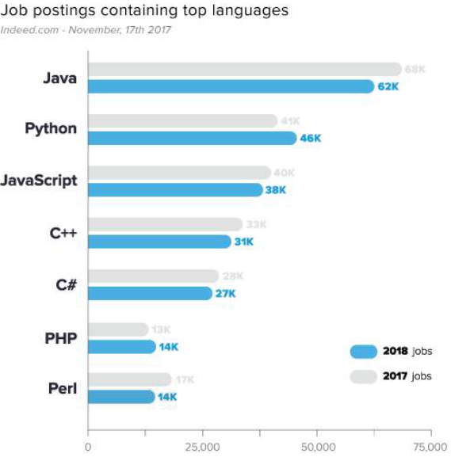
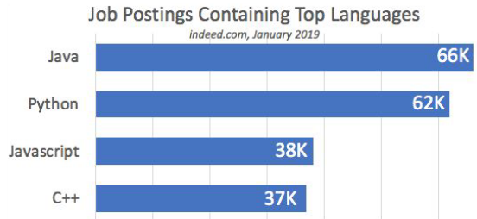
1- Choice of Programming Language

Slide 8
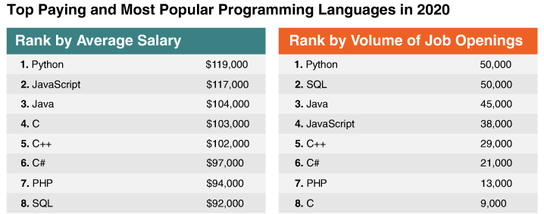
1- Choice of Programming Language
How to learn a programming language?
Choose the best language for your goals and skills.
Understand computational thinking.
Enroll in online resources.

Slide 9
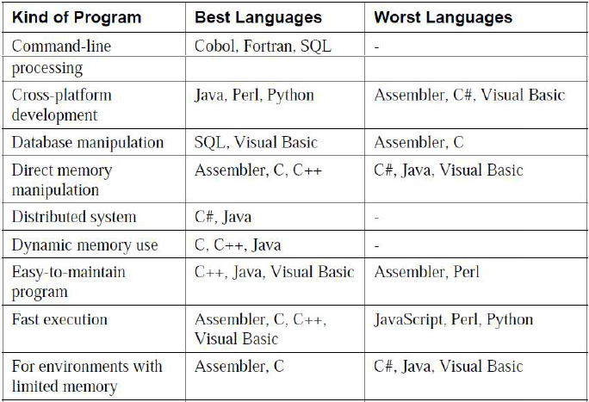
1- Choice of Programming Language

Slide 10
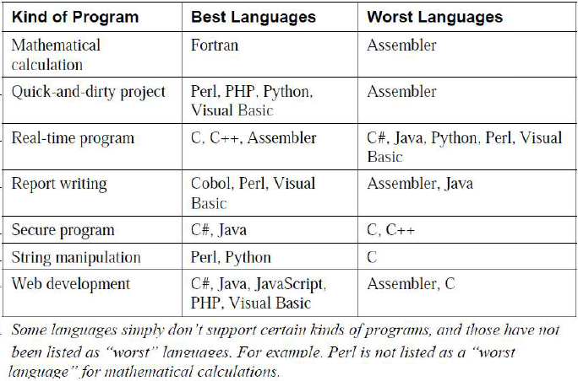
1- Choice of Programming Language

Slide 11
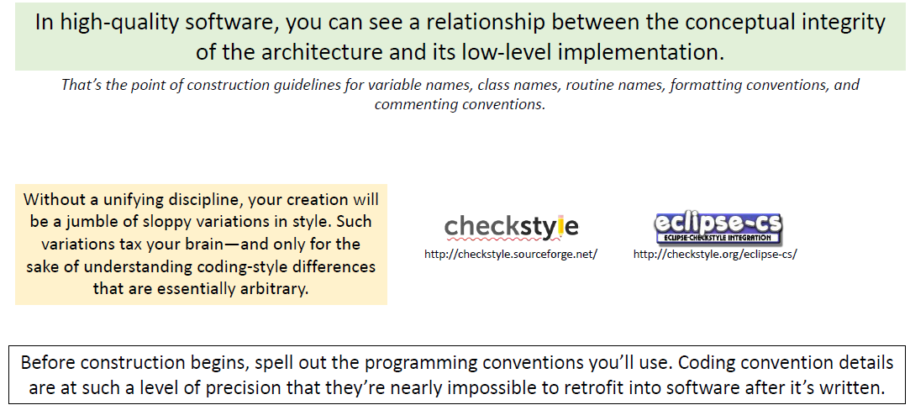
2- Programming Conventions

Slide 12
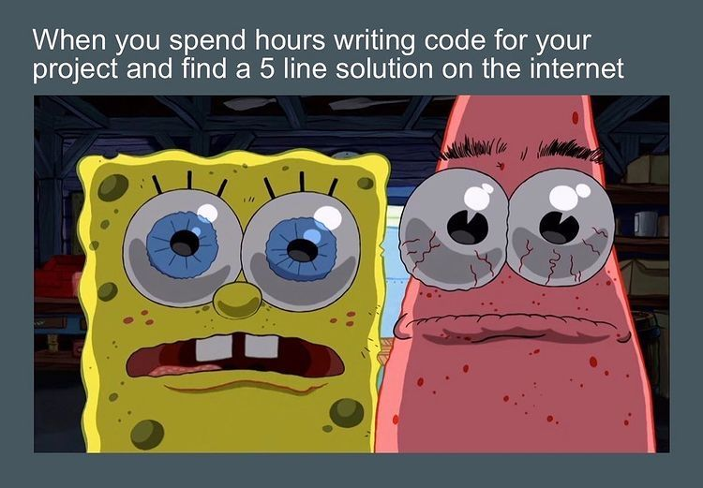

3- Your Location on the Technology Wave
How you spend your programming days will depend on where you are on the technology wave.

Slide 13
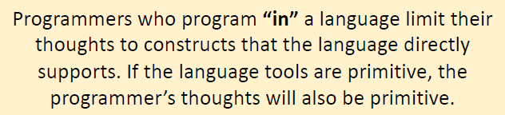
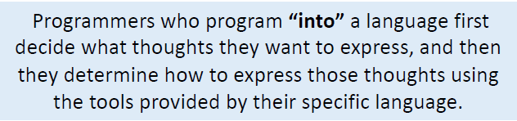
3- Your Location on the Technology Wave
Primitive environment
Mature environment

Slide 14
4- Selection of Major Construction Practices
Deciding which of the many available good practices you’ll emphasize
Major construction practices:
Coding.
Team work.
Quality assurance.
Tools.

Slide 15
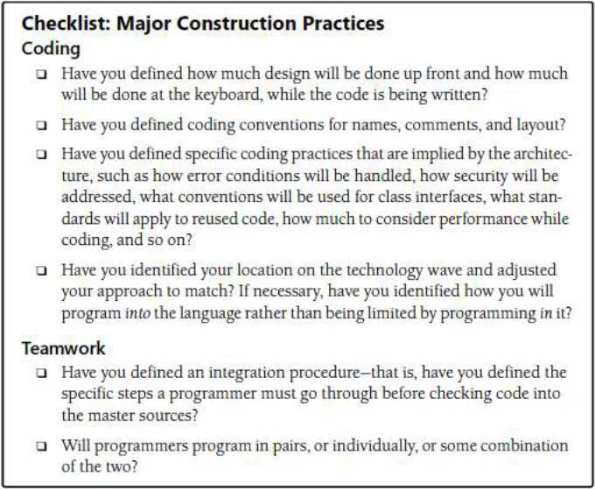
4- Selection of Major Construction Practices

Slide 16
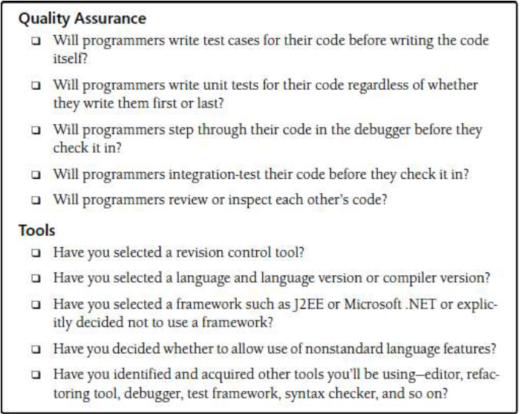
4- Selection of Major Construction Practices

Slide 17
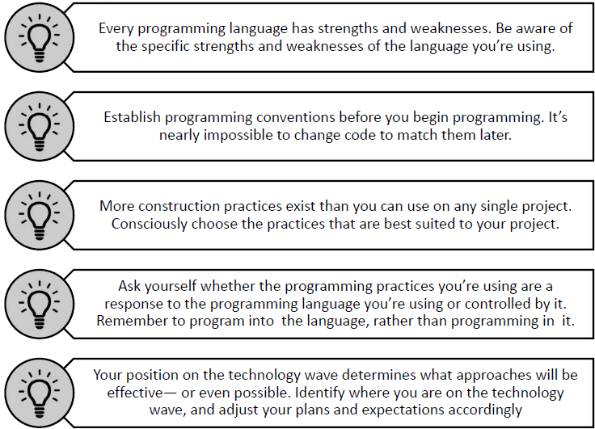
Summary

Slide 18
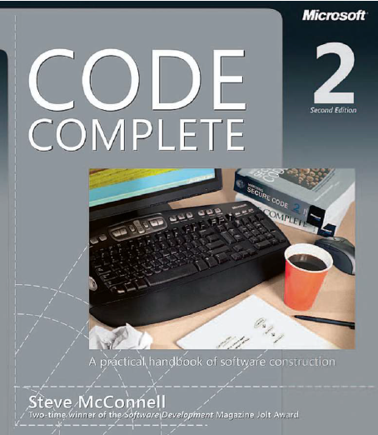
Reading
Code Complete: A Practical Handbook of Software Construction, 2nd Edition, Steve McConnell.
Chapter 4

Slide 19

Any questions? ​
Please feel free to raise your hands and ask.

